Slide 1

AgriLoop
Beyond the Crop, There’s Value in Waste
Presented by:
Trilok KR | Shalini K | Varsha R | Lathika S

Slide 2
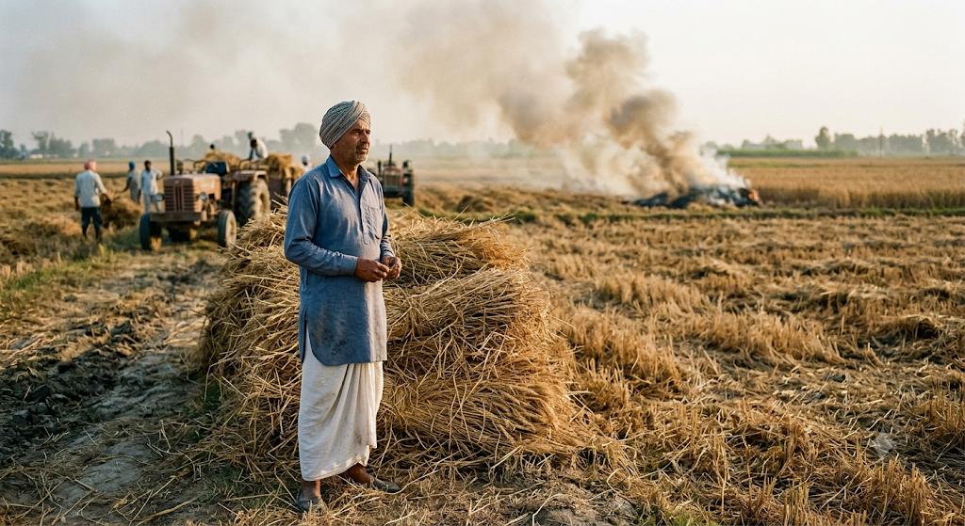
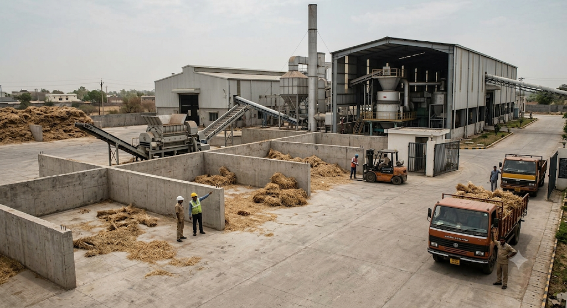
Problem Statement
Agricultural crop residue is generated in large quantities after harvesting, yet much of it is still treated as waste and openly burned due to the lack of accessible, profitable disposal alternatives. Farmers often struggle to find nearby buyers, transparent prices, and dependable pickup services, while biomass-based industries face difficulty sourcing consistent quantities of suitable crop residue.
his disconnect creates a broken supply chain where valuable biomass is wasted, farmers lose potential income, and residue burning contributes to air pollution, greenhouse-gas emissions, and soil degradation.
AgriLoop addresses this gap by creating a digital marketplace that connects farmers directly with biomass buyers and logistics providers, making crop residue easier to sell, collect, and reuse.

Slide 3
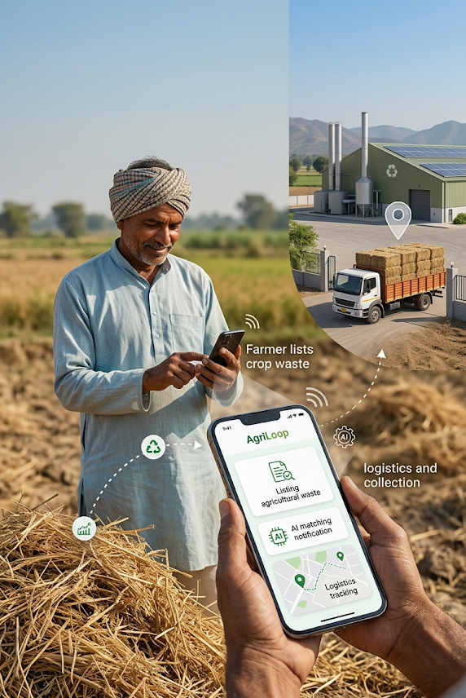

Proposed Solution
  AgriLoop is an AI-powered digital marketplace that connects farmers, biomass buyers, and logistics providers on one platform. Farmers can list crop residue, while AI matches available supply with nearby demand based on type, quantity, quality, and distance. Integrated route optimization and GPS tracking simplify collection and delivery, turning agricultural waste into a profitable and usable resource.
  AgriLoop transforms agricultural crop waste into a profitable resource by digitally connecting farmers with biomass buyers and logistics providers. Farmers can list available residue with minimal effort, while AI identifies suitable buyers based on residue type, quantity, location, demand, and pickup feasibility. The platform coordinates collection, optimizes transportation, and enables transparent digital transactions.

Slide 4

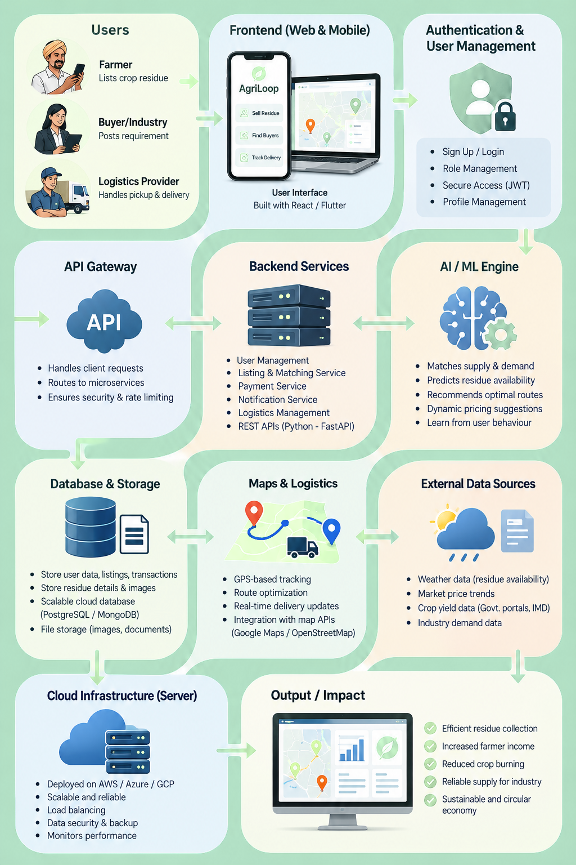
Technical Stack

Slide 5


Methodology
Crop residue type
Back to Agenda
Data Collection
Farmer location
Methodology
Quantity & availability
Digital Transaction
AI Matching
Supply-demand matching
Price estimation
Smart Logistics
Distance optimization
Start local, prove the model, then scale.
Pilot AgriLoop with a small group of farmers, buyers, and logistics providers to validate AI matching, pickup efficiency, and residue recovery before expanding regionally.

Slide 6




Challenges and Objectives
Challenges
Objectives
  Crop residue burning due to limited disposal alternatives.
  Loss of potential farmer income from unused biomass.
  High transportation and collection costs.
  Unreliable residue supply and quality for industries.
  Create an accessible marketplace for farmers to sell crop residue.
  Increase farmer income by converting waste into a valuable resource.
  Enable AI-based matching between residue suppliers and buyers.
  Promote sustainable and circular use of agricultural biomass.

Slide 7
SWOT
Strengths | Weaknesses | Opportunities | Threats
AI-powered matching connects farmers directly with biomass buyers. Integrated logistics simplifies pickup, delivery, and payment. | Requires sufficient farmer and buyer participation to build network value. Residue quality and quantity can vary across farms. | Growing demand for biomass, biofuels, compost, and sustainable packaging. Can expand across crop-producing regions and support circular agriculture. | Competition from existing local traders and informal markets. Seasonal residue availability and changing market prices.

Slide 8
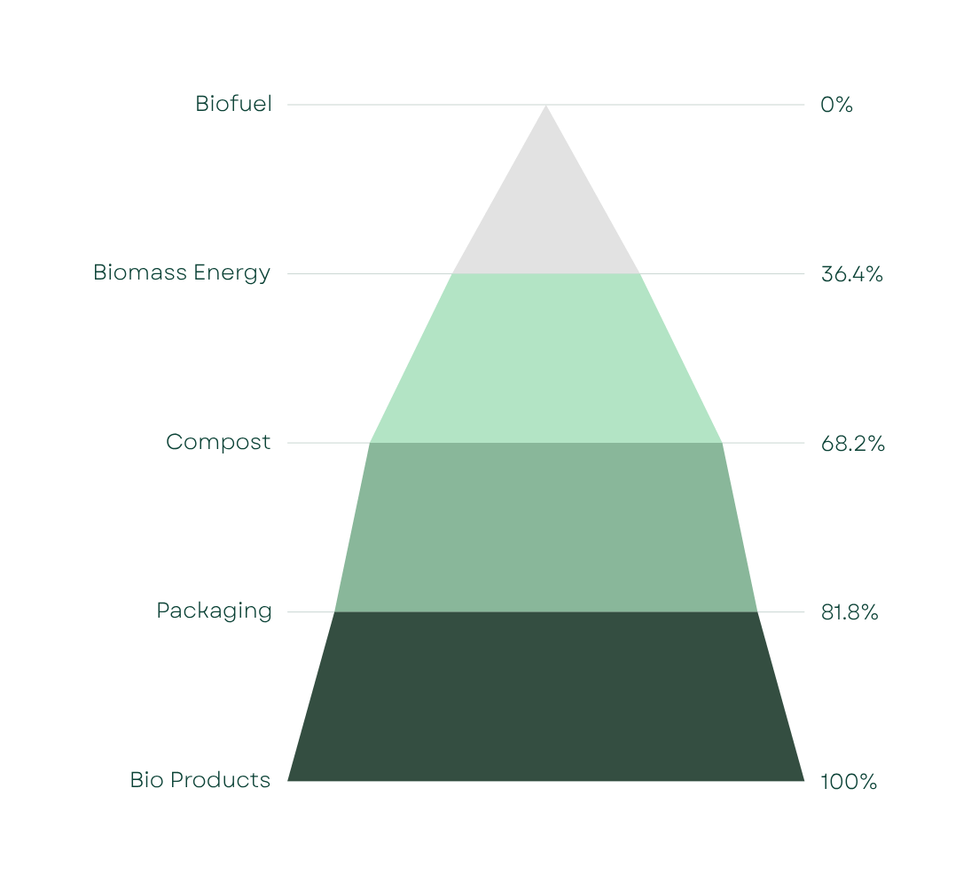


Industry Analysis
Agricultural Biomass Is Becoming a Valuable Resource
The demand for crop residue is expanding across biofuels, biomass energy, composting and sustainable packaging. However, supply remains fragmented, making farmer connectivity, collection and reliable procurement major challenges.
Waste → Resource → Market
Source: Government agriculture reports, biomass industry studies & market research

